Slide 1
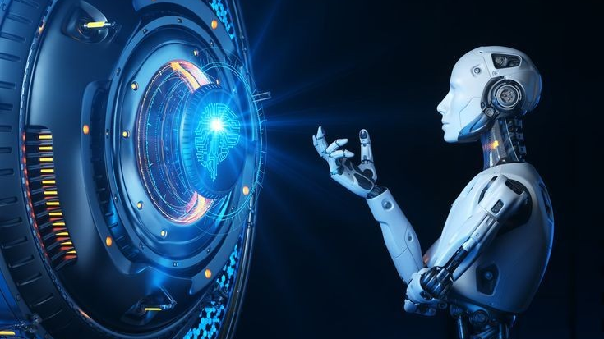
COURSE PORTFOLIO

Slide 2

AGENDA
Chapter 1 & 2
Chapter 3 & 4
Chapter 5 & 6
VISUAL AIDS
Chapter 7 & 8
Chapter 9 & 10
VISUAL AIDS

Slide 3
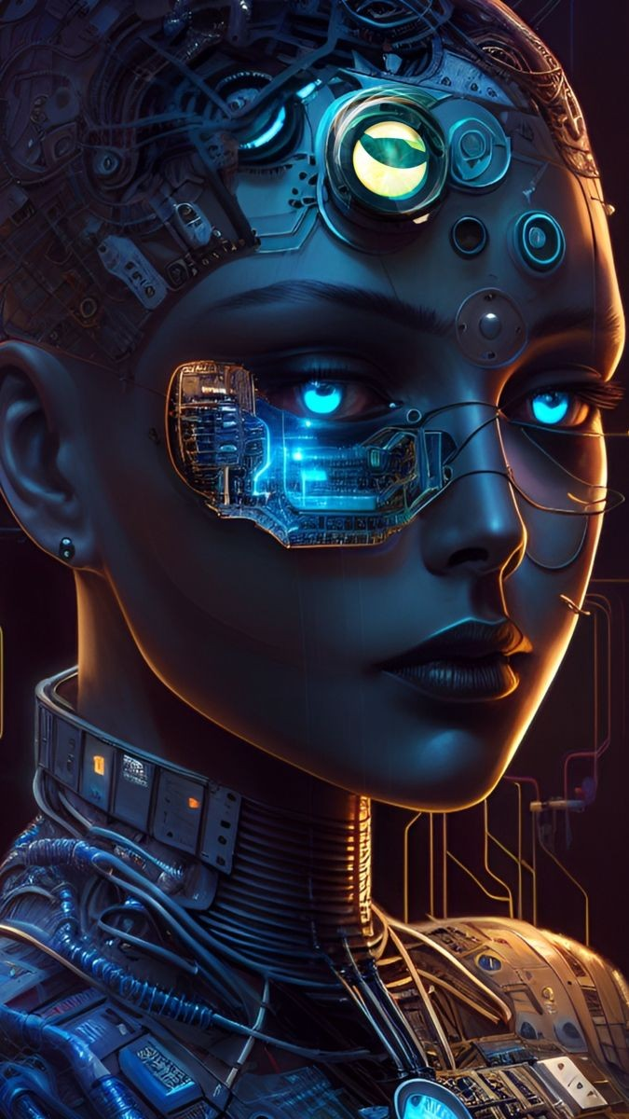
Module 1 & 2
Computer Vision & Cameras and Sensors

Slide 4
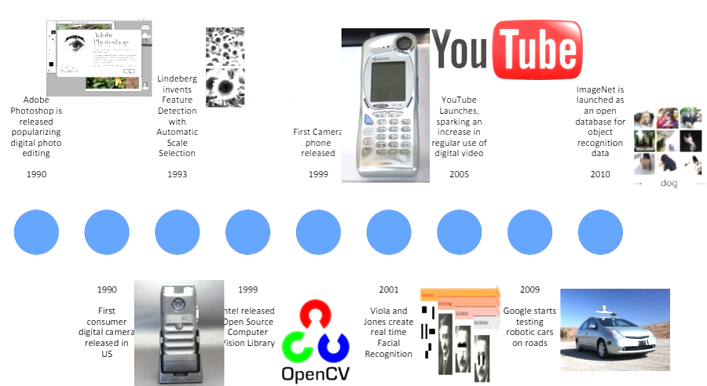
Module 01 introduces us computer vision, emphasizing the latest advancements in AI, GPU technology, and cloud computing. It covers fundamentals, image and video generation tools like DALL-E and GauGAN2, and key algorithms such as GANs and VAEs, highlighting applications in autonomous driving, space exploration, and healthcare. Module 02 focuses on the types and specifications of cameras and sensors used in computer vision, including RGB, depth, thermal, and stereo cameras, as well as LiDAR and radar. It explains the importance of camera calibration and setup for accurate 3D reconstruction, essential for applications in robotics, automotive, and surveillance.

Slide 5
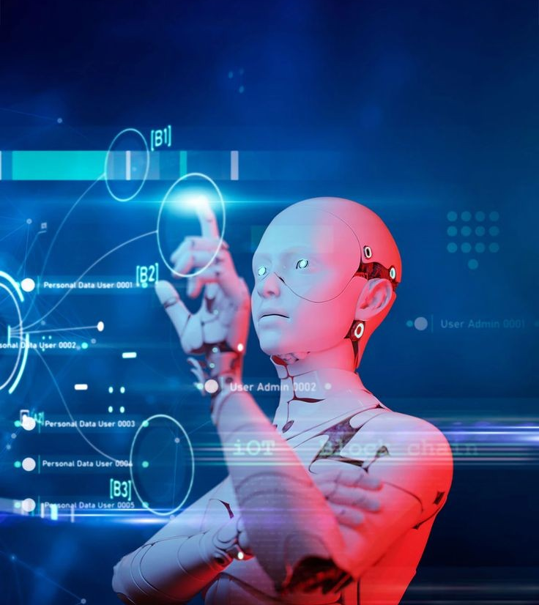
Module 3 & 4
Image Fundamentals and Image Processing

Slide 6
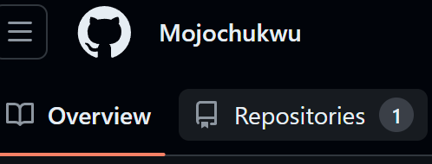
Fundamentals of Image Processing covers essential tools and techniques in computer views and processes images. We explored various development environments, including local tools like Visual Studio Code and cloud-based platforms such as Google Colab, AWS Sagemaker StudioLab which was like our playground for our projects, and we were also introduced to Jupyter Notebook, Github (repository) and Google Gemini Code. We were also taught the differences between libraries and frameworks, highlighting popular libraries like OpenCV and Pillow for their real-time and basic image manipulation capabilities.
The Prof explained how computers "see" images as matrices of pixels and cover fundamental image processing techniques, including enhancement, segmentation, restoration, and compression. The key takeaway is the importance of understanding and utilizing these tools for efficient and collaborative development in fields like medical imaging, satellite imaging, facial recognition, and object detection to help improve and make our society a better place.

Slide 7
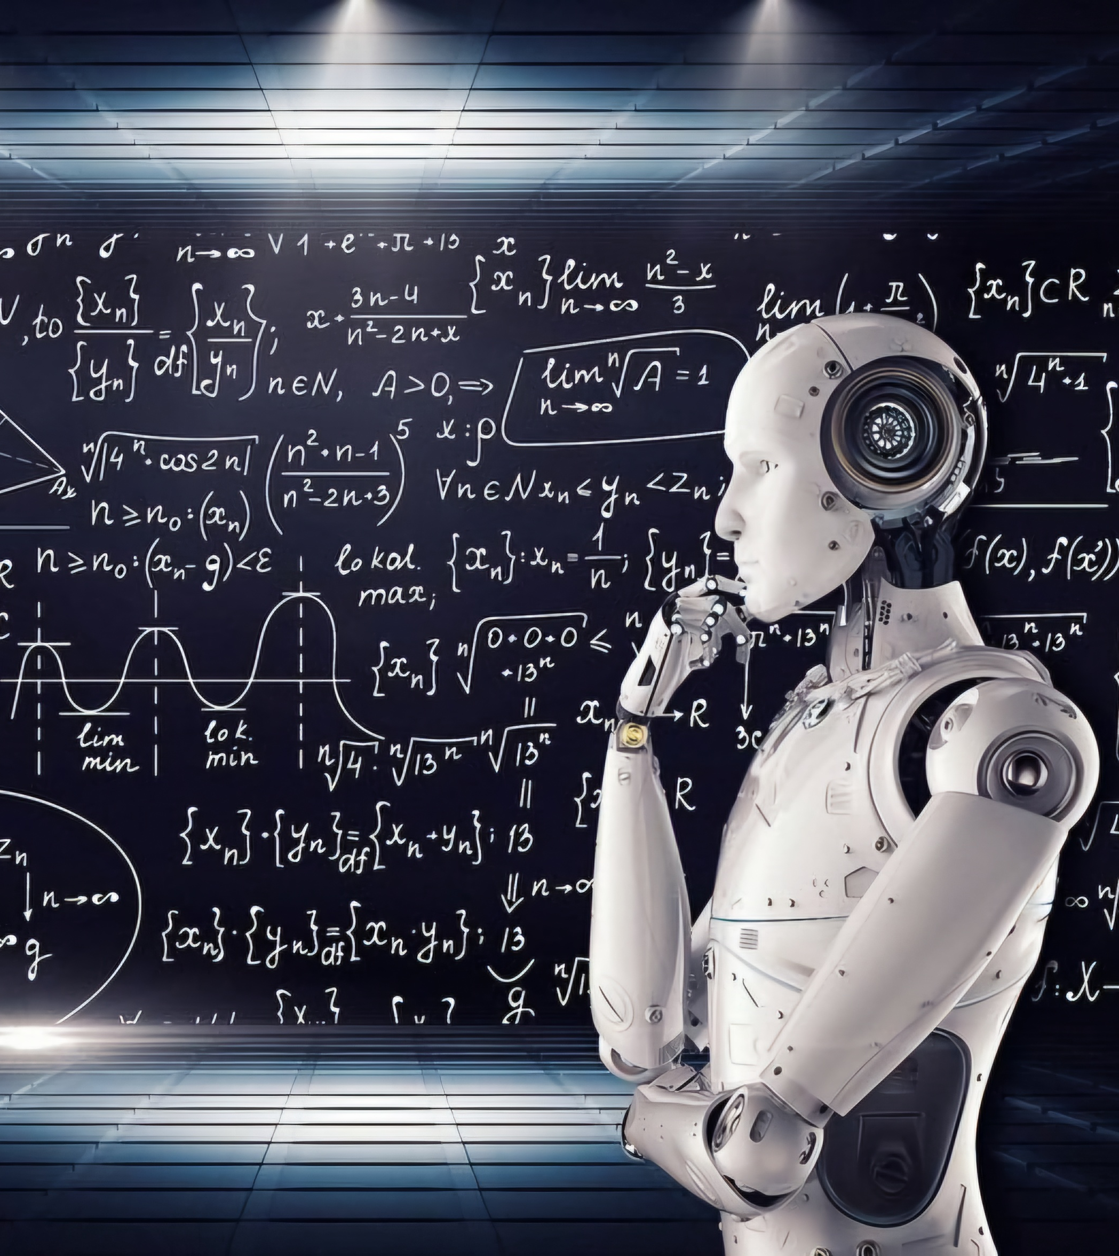
Module 5 & 6
Machine Learning for Computer Vision and Introduction to Neural Networks

Slide 8
Deep learning is a subset of machine learning that uses artificial neural networks to mimic the learning process of a human brain. Machine learning teaches how it learns and adapt automatically without much human assistance while including types of data, supervised and unsupervised learning, and the machine learning lifecycle. We also learned the importance of features, labels, and the ML problem-solving process. Neural networks is about the structure and function, including artificial neurons, activation functions, and the training process using backpropagation and gradient descent. It contrasts traditional ML with deep learning, highlighting the latter's ability to learn features automatically.
Both address challenges such as data requirements, computational demands, and model evaluation, providing a solid foundation in understanding and applying machine learning and neural networks to real-world problems. The lab work TensorFlow playground and Chihuahua or muffin was used to demonstrate these topics which was rreally an eye opner and a very well received experience for me because it showed how tough it is for computers to learn and make accurate predictions on the subjects.
I`ll be attaching some images below for some reference

Slide 9
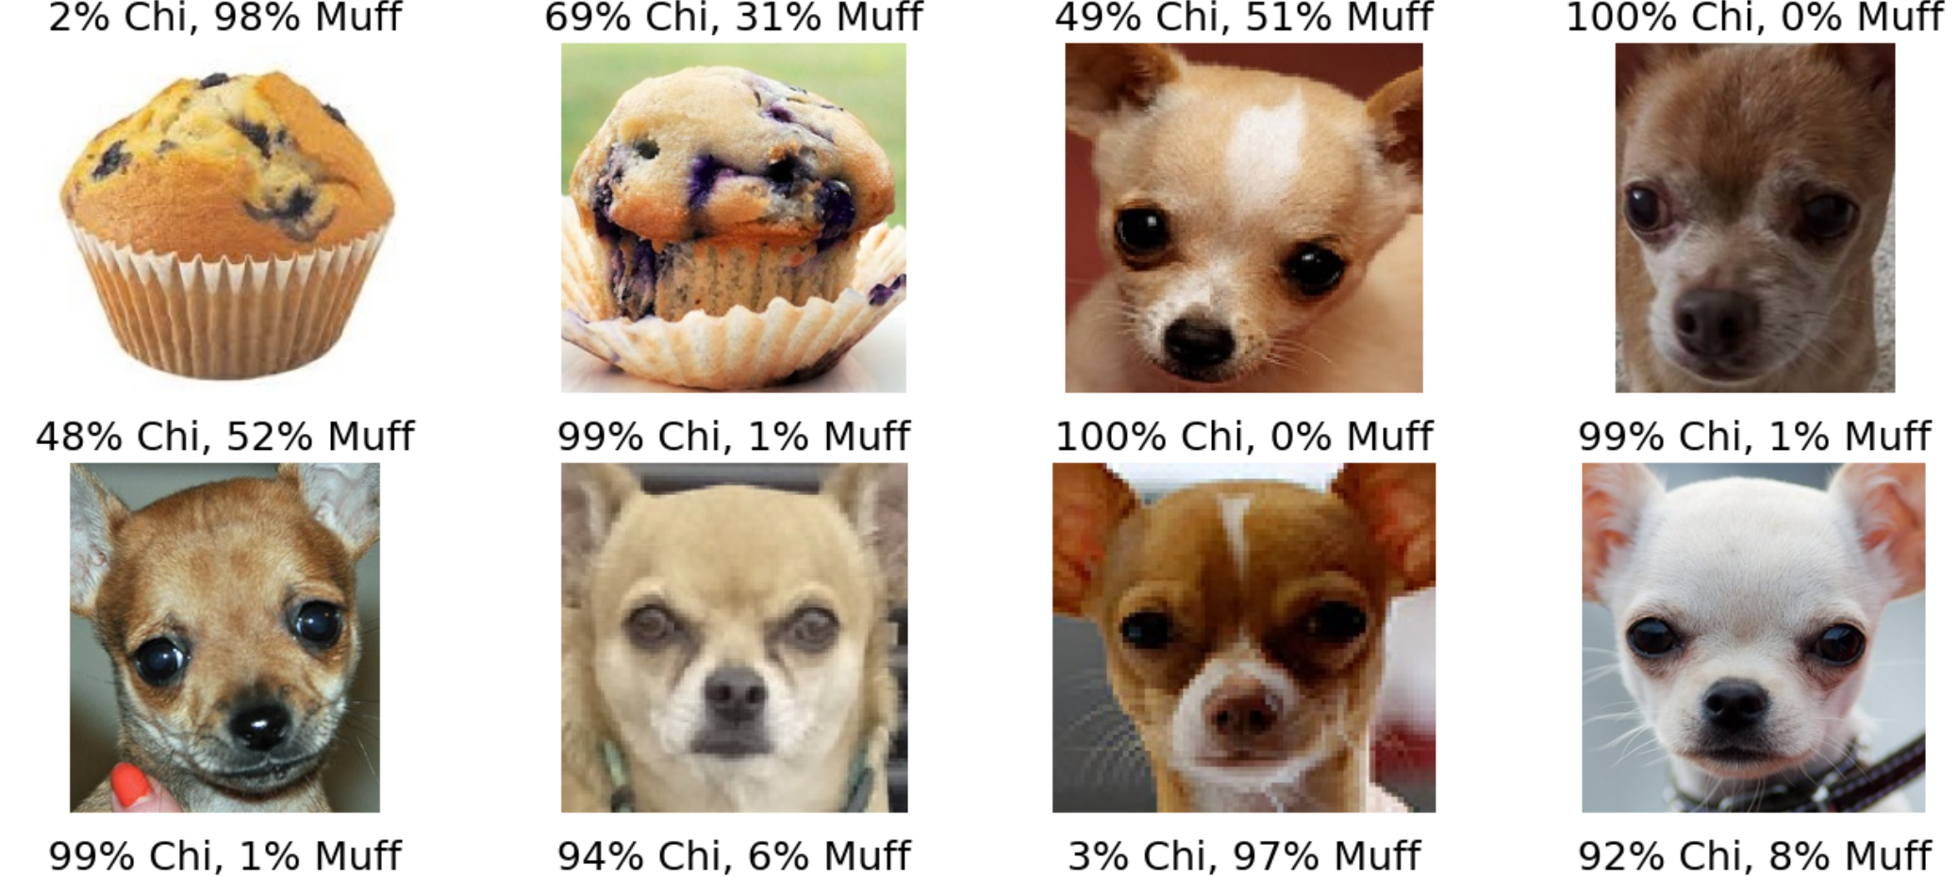
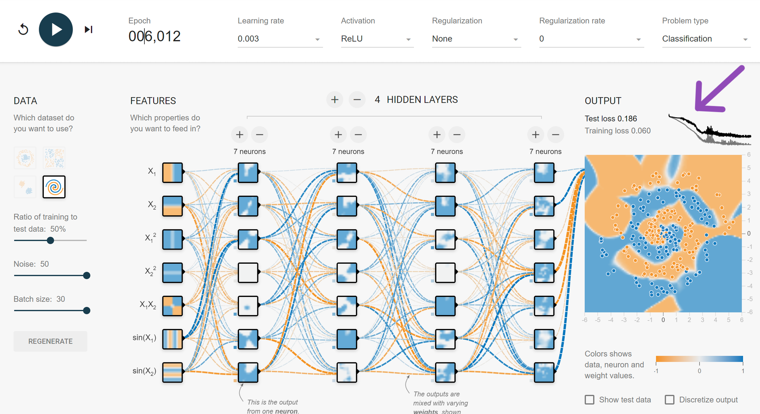
My Lab experiences

Slide 10
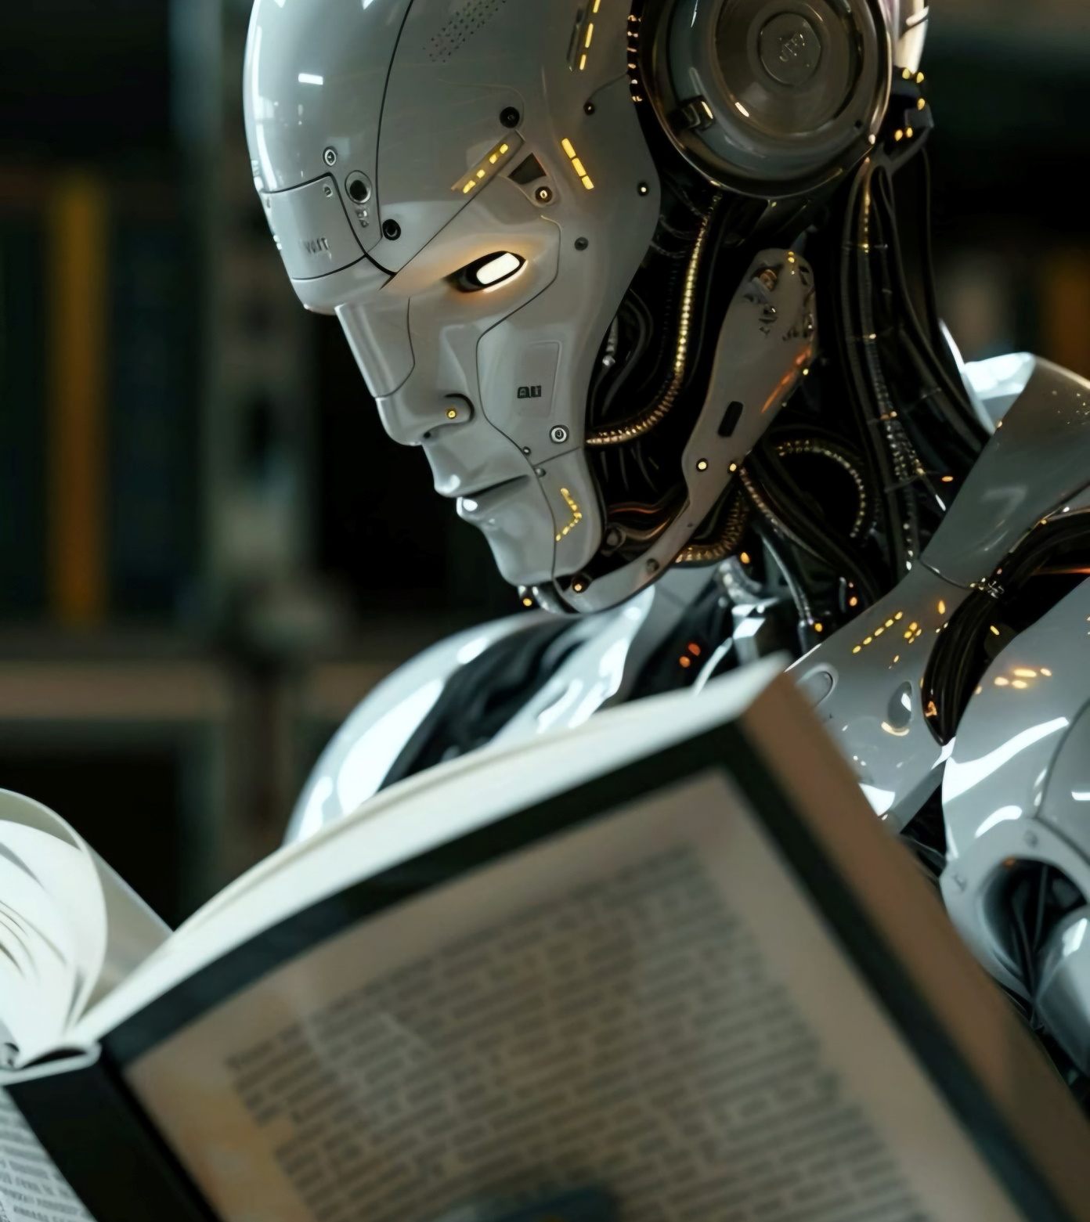
Module 7 & 8
Convolutional Neural Networks and Basic CNN Architectures and Transfer Learning

Slide 11
Transfer learning, a key focus of the presentation, involves using pre-trained models on new but related tasks to save time and resources while improving performance, especially with limited data. By leveraging models like VGG, ResNet, and Inception, transfer learning allows for efficient adaptation of generic features learned from vast datasets to specific tasks. The presentation also introduces specialized toolkits such as NVIDIA Transfer Learning Toolkit and TensorFlow Hub, which streamline the implementation of transfer learning, highlighting its practicality and importance in modern machine learning and computer vision applications.
Convolutional Neural Networks (CNNs) and transfer learning explores the foundational aspects of CNN architectures and the principles of transfer learning. CNNs, with their specialized layers such as convolutional and pooling layers, excel at preserving spatial hierarchies in image data, making them highly effective for tasks like image recognition and object detection. The presentation highlights two pivotal CNN models: LeNet, which laid the groundwork for CNN applications in digit recognition in the 1990s, and AlexNet, which revolutionized the field by winning the 2012 ImageNet competition through innovations like ReLU activation, GPU usage, and data augmentation techniques.

Slide 12
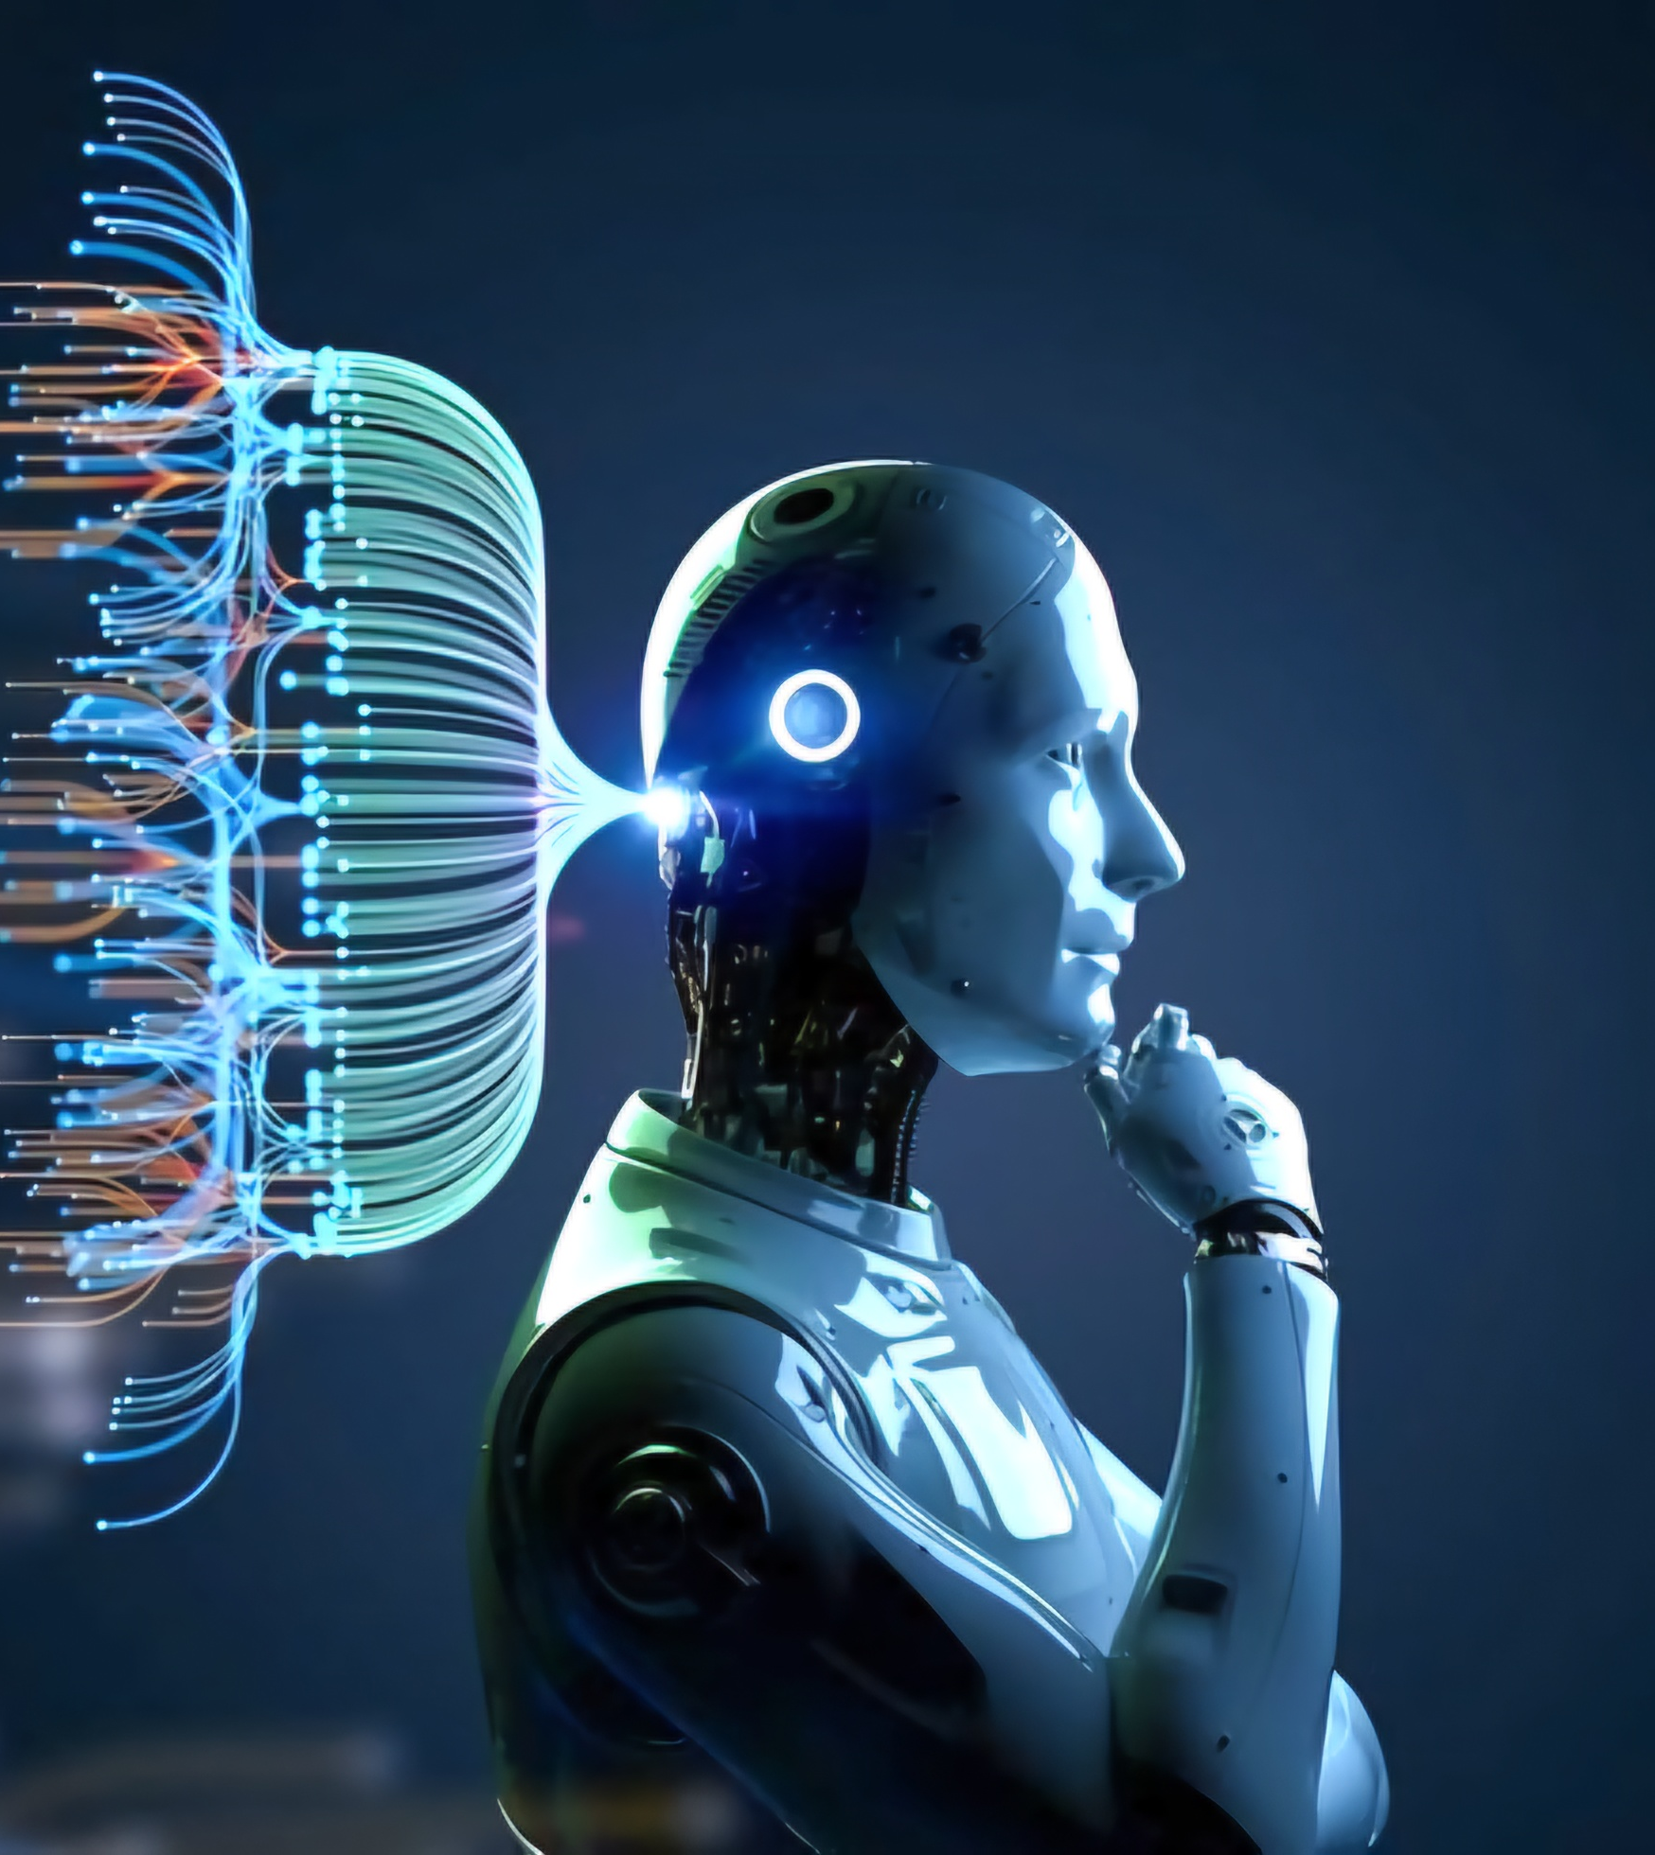
Module 9 & 10
Convolutional Neural Networks and Basic CNN Architectures and Transfer Learning

Slide 13
While the Video Fundamentals teaches the focus shifts to understanding and analyzing video data for computer vision applications. Key topics include the basics of video representation, such as frame rate, resolution, and color spaces, alongside pre-processing techniques like frame extraction, resizing, and normalization to prepare video data for analysis. It also covers motion estimation, object detection, and tracking within video frames, using models like YOLO and SSD, and techniques like Kalman and particle filters for tracking moving objects. Advanced topics include action recognition, which leverages deep learning models like CNNs, RNNs, and transformers to understand movements and interactions over time. The module highlights the practical applications of video analysis in fields like surveillance, sports analysis, and autonomous vehicles, and addresses ethical considerations such as privacy, consent, and bias in the deployment of these technologies.
The Advanced Architectures teaches the evolution and applications of convolutional neural networks (CNNs) in computer vision, starting with foundational architectures like LeNet and AlexNet. It covers the significant advancements brought by transfer learning, where pre-trained models on large datasets like ImageNet are fine-tuned for specific tasks, enhancing efficiency and performance. The course also explores advanced CNN architectures such as VGGNet, GoogLeNet, and ResNet, highlighting their contributions to improved accuracy and efficiency. Additionally, it addresses object detection techniques, comparing two-stage detectors like Faster R-CNN, which generate region proposals before classification, and one-stage detectors like YOLO and SSD, which streamline the process into a single step. The importance of evaluation metrics, including Intersection over Union (IoU) and mean average precision (mAP), is emphasized to measure model performance accurately.

Slide 14
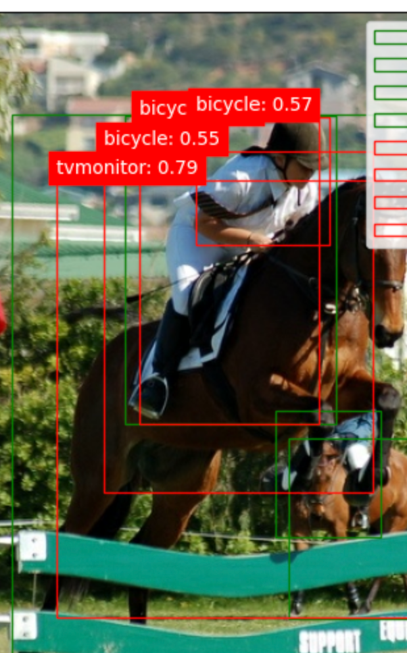
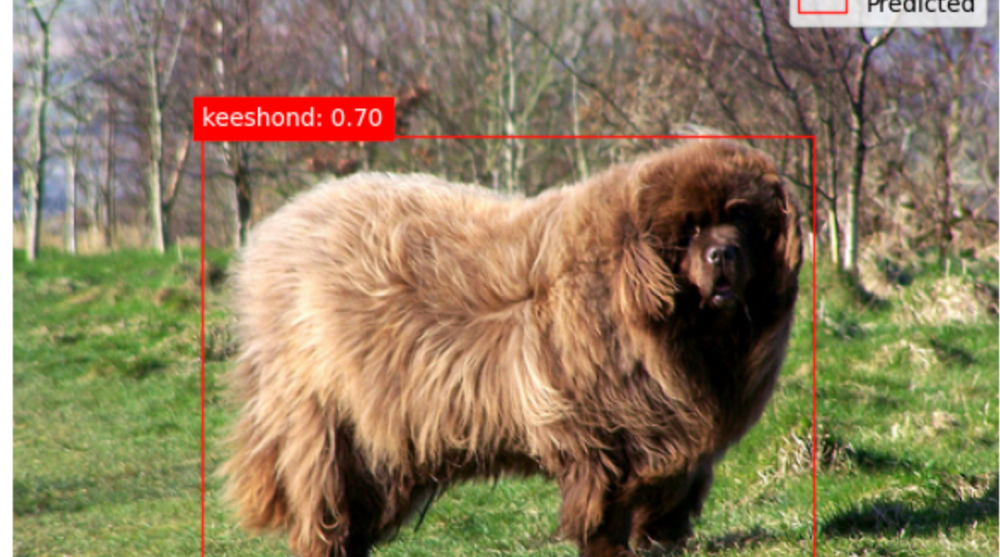
MY Lab Experiences

Slide 15
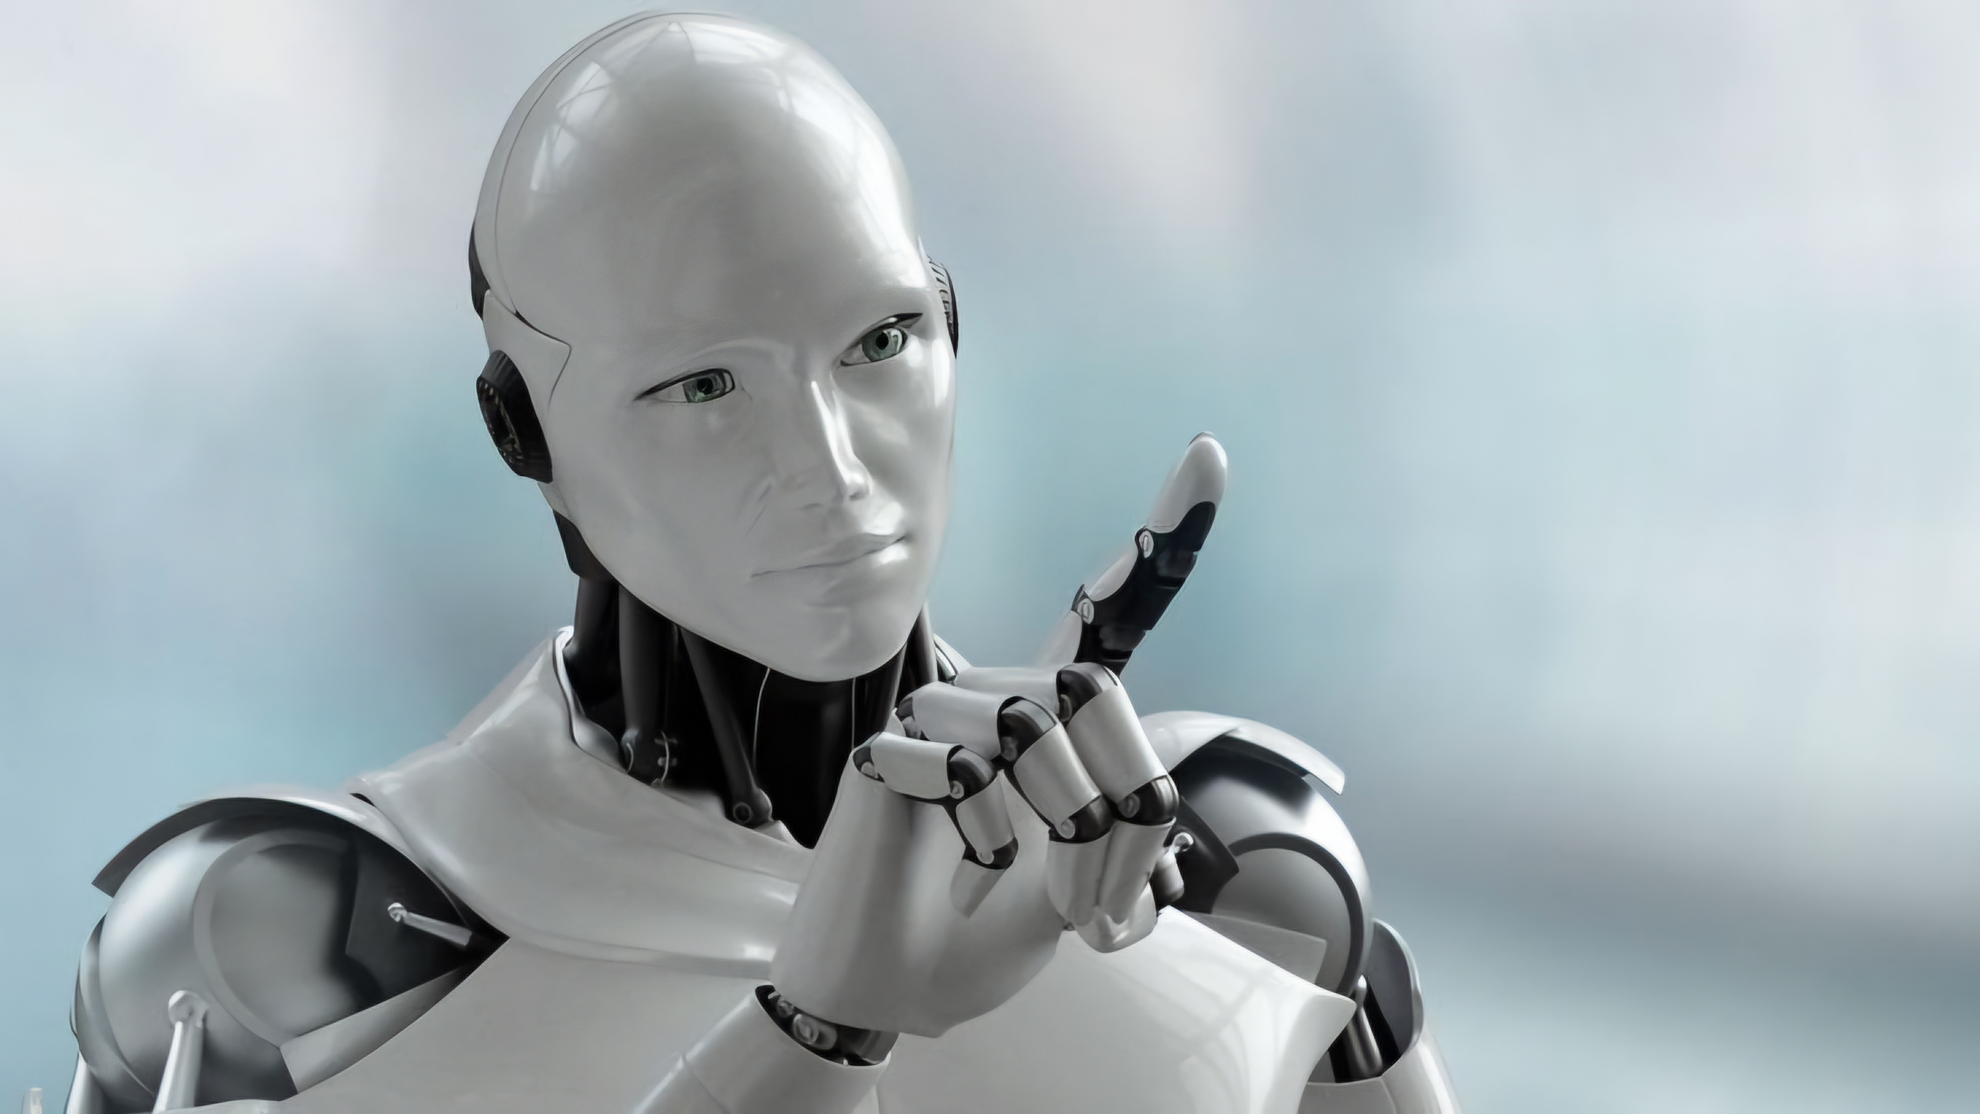
THANK YOU
Munachimso Benson
ITAI 1378

